Slide 1





WebDriver Advanced
Alerts, Actions, Data Bind Tests Simple Logger
QA
Automation
SoftUni Team
Technical Trainers
Software University
http://softuni.bg

Slide 2

Table of Contents
Pop-ups
Handle pop-up, alerts, new tabs
Actions
Keyboard and Mouse Events
Data Driven Testing
Excel Object Model
Basic Logger

Slide 3
Have a Question?
sli.do #QA-Automation

Slide 4

Pop-up
Handle Pop-ups and Alerts

Slide 5
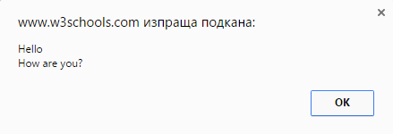
Pop-up
Graphical user interface display area, that suddenly appears in the foreground of the visual interface
Alerts
Windows
Tabs
Frames

Slide 6
SwitchTo()
Methods available under WebDriver API for Switch Commands
Switches focus to element that has focus at the moment
Switches focus to currently active dialog box
Switches focus to the window with specified name
driver.SwitchTo().ActiveElement();
driver.SwitchTo().Alert();
driver.SwitchTo().Window(string windowName);

Slide 7
SwitchTo()
Switches focus to frame by given index
Switches focus to parent frame of currently selected frame
Switches focus to the first frame on the page or main document
driver.SwitchTo().Frame(int index);
driver.SwitchTo().ParentFrame();
driver.SwitchTo().DefaultContent();

Slide 8
Alerts
Alerts can be Instantiate
Alert methods
Alert message
IAlert alert = driver.SwitchTo().Alert();
alert.Accept();
alert.Dismiss();
alert.SendKeys("Any string");
Assert.AreEqual("Expected", alert.Text);

Slide 9

Problem: Pop-up
Open http://toolsqa.com/automation-practice-switch-windows/
Click button "New Browser Tab"
Check logo have "src" attribute: http://toolsqa.com/wp-content/uploads/2014/08/Toolsqa.jpg
Close previous open tab
Check that driver handles only one window

Slide 10
Solution: Alerts
IWebDriver driver = new ChromeDriver();
driver.Url =
"http://toolsqa.com/automation-practice-switch-windows/";
var newTabBtoon = driver.FindElement(By.XPath(Add XPath));
newTabBtoon.Click();
string newTabName = driver.WindowHandles.Last();
var newTab = driver.SwitchTo().Window(newTabName);
Assert.AreEqual("QA Automation Tools Tutorial", driver.Title);
newTab.Close();
Assert.IsTrue(driver.WindowHandles.Count == 1);

Slide 11

Actions
Keyboard and Mouse Events

Slide 12
Keyboard and mouse Events
Handling special keyboard and mouse events are done using the using OpenQA.Selenium.Interactions
Actions Builder
Actions builder = new Actions(driver);
builder.MoveToElement(field).Perform();
Executing the action object

Slide 13
Keyboard Events
KeyDown() is press key and hold it pressed
KeyUp() is used to release a key you already hold
SendKeys() sends a series of keystrokes onto the element.
builder.KeyDown(Keys.Shift);
builder.KeyUp(Keys.Shift);
builder.KeyDown(Keys.Shift)
.SendKeys(element, "hello");

Slide 14
Mouse Events
Click left button at the current mouse location.
Click right button at the current mouse location.
Double click left button at the current mouse location
builder.Click();
builder.ContextClick();
builder.DoubleClick();

Slide 15
Mouse Events (2)
Moves the mouse to the middle of the element.
Clicks (without releasing) at the current mouse location.
Releases the pressed left mouse button at the current mouse location
builder.MoveToElement(field);
builder.MoveToElement(field).ClickAndHold();
builder.MoveToElement(field).Release();

Slide 16
DragAndDrop()
Performs click-and-hold from source element, moves to target element, then releases the mouse
Performs click-and-hold from source element, moves by a given offset, then releases the mouse.
Negative offset is moving left on X and moving top on Y
Builder.DragAndDrop(sourseElem, targetElem);
Builder.DragAndDropToOffset
(sourseElem, OffsetX, OffsetY);

Slide 17
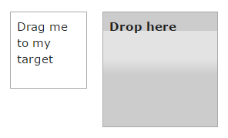
Problem: DragAndDrop
Open http://demoqa.com/droppable/
Drag element to the its target

Slide 18
Solution: DragAndDrop
IWebDriver driver = new ChromeDriver();
driver.Url = "http://demoqa.com/droppable/";
var source =
driver.FindElement(By.XPath("//*[@id=\"draggableview\"]/p"));
var target = driver.FindElement(By.Id("droppableview"));
string classBefore = target.GetAttribute("class");
Actions builder = new Actions(driver);
builder.DragAndDrop(source, target).Perform();
string classAfter = target.GetAttribute("class");
Assert.AreNotEqual(classBefore, classAfter);

Slide 19
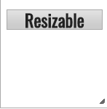
Problem: Resize
Open http://demoqa.com/resizable/
Resize item in box so:
Width to be 100px bigger
Height to be 100px bigger

Slide 20
Solution: Resize
IWebDriver driver = new ChromeDriver();
driver.Url = "http://demoqa.com/resizable/";
var div = //TODO: Find div and get it size
var arrow = //TODO: Find arrow
Actions builder = new Actions(driver);
var action = builder.MoveToElement(arrow)
.ClickAndHold().MoveByOffset(100, 100).Release();
action.Perform();
Assert.AreEqual(width + 100, div.Size.Width);
Assert.AreEqual(height + 100, div.Size.Height);

Slide 21

Project Configurations
Enviroment, Database Configuration

Slide 22
What is Project Configuration?
We always use Urls, DB Connection String and Folder paths in any automation project (any project)
You want to change it on one place, NOT in every test
When test environment change
When you prepare a new data source
When your paths change

Slide 23
App.config
Application config files inherit settings from global configuration files, e.g. the machine.config
<?xml version="1.0"?>
<configuration>
<connectionStrings>
<add name="MyKey"
connectionString="Data Source=localhost;
Initial Catalog=ABC;"
providerName="System.Data.SqlClient"/>
</connectionStrings>
</configuration>

Slide 24
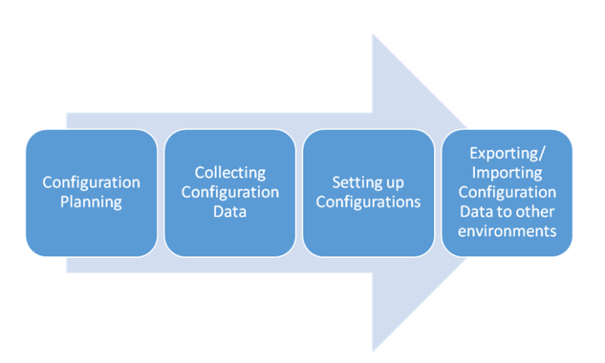
Problem: Project Configuration
Add Аpp.config
Add Еnvironment.config
Add Paths.config

Slide 25
Solution: Project Configuration
Еnvironment.config
<appSettings>
<add key="URL" value="http://www.store.demoqa.com"/>
<add key="TestDataSheetPath" value="YourPath"/>
<add key="Logs" value="YourPath"/>
</appSettings>

Slide 26
Solution: Project Configuration (2)
App.config
<?xml version="1.0" encoding="utf-8" ?>
<configuration>
<appSettings
configSource="Configurations\Environment.config" />
</configuration>

Slide 27
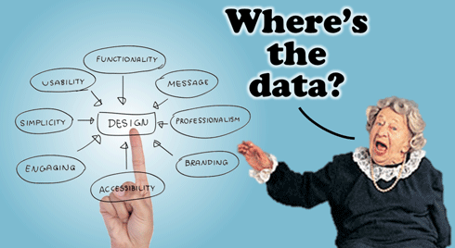
Data Driven Tests
Data Bind by Excel Files

Slide 28
What is Data Driven Testing?
Data-driven testing is the creation of test scripts to run together with their related data sets in a framework
Table of conditions directly as test inputs and verifiable outputs
Process where test environment settings and control are NOT hard-coded

Slide 29

Data Formats
Data pools
Excel files
ADO objects
CSV files
ODBC sources

Slide 30

OLE DB
OLE DB is a COM-based application programming interface (API) for accessing data
OLE DB is part of the Microsoft Data Access Components (MDAC)
OLE DB is conceptually divided into consumers and providers

Slide 31
OLE DB Connection
OLE DB Connection instance takes Connection String as argument and pass the value to the Constructor statement
var connection = string.Format
(@"Provider=Microsoft.ACE.OLEDB.12.0;
Data Source = {0};
Extended Properties=Excel 12.0;",
fileName);
var connection = new OleDbConnection(connection)

Slide 32
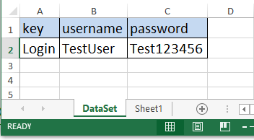
Excel File Rules
Sheet name have to be unique
First row will be our properties names
First row will be our key (test name)
You need to download 2007 Office System Driver: Data Connectivity Components

Slide 33

Dapper
Dapper is a simple object mapper for .NET
Get it like NuGet

Slide 34

Problem: Create Data Bind SoftUni Login
Add Data Driven Test for login in Softuni
Add one positive test case
Add one negative test case

Slide 35
Solution: Create Data Bind SoftUni Login
class ExcelDataAccess
{
public static string TestDataFileConnection()
{
var fileName =
ConfigurationManager.AppSettings["TestDataSheetPath"];
var con = string.Format(
@"Provider=Microsoft.ACE.OLEDB.12.0;
Data Source = {0};
Extended Properties=Excel 12.0;", fileName);
return con;
}
Continues on next slide!!!

Slide 36
Solution: Create Data Bind SoftUni Login
public static UserData GetTestData(string keyName)
{
using (var connection = new
OleDbConnection(TestDataFileConnection()))
{
connection.Open();
var query = string.Format("select * from [DataSet$]
where key='{0}'", keyName);
var value = connection.Query<UserData>(query)
.FirstOrDefault();
connection.Close(); return value;
}
}

Slide 37
Solution: Separate Page Elements Asserter
public class UserData
{
public string Key { get; set; }
public string Username { get; set; }
public string Password { get; set; }
}
var userData = ExcelDataAccess.GetTestData(testName);

Slide 38
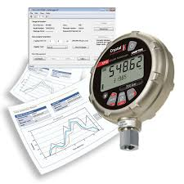
Basic Logger
Log txt Files and Take Screenshots

Slide 39
TestContext Object
Each NUnit test runs in an execution context, which includes information about the environment as well as the test itself
CurrentContext
Gets the context of the currently executing test
This context is created separately for each test before it begins execution
Out
Gets a TextWriter used for sending output to the current test result.

Slide 40
Problem: Add Logger to SoftUni Test
Add Logger for your test cases
Log all test in single txt file
For every failed test do screen shot with test name

Slide 41
Solution: Add Logger to SoftUni Test
if (TestContext.CurrentContext.Result.Outcome.Status ==
TestStatus.Failed)
{
string path = ConfigurationManager.AppSettings["Logs"] +
TestContext.CurrentContext.Test.Name + ".txt";
File.WriteAllText(path, TestContext.CurrentContext
.Test.FullName +
" " + sb.ToString());
var screenshot = ((ITakesScreenshot)driver).GetScreenshot();
screenshot.SaveAsFile(path + TestContext.CurrentContext
.Test.Name + ".jpg",
ScreenshotImageFormat.Jpeg);
}

Slide 42

Summary
Pop-ups
Handle pop-up, alerts, new tabs
Actions
Keyboard and Mouse Events
Data Driven Testing
Excel Object Model
Basic Logger

Slide 43








Selenium WebDriver Design Patterns
https://www.w3schools.com/xml/xpath_axes.asp

Slide 44
License
This course (slides, examples, demos, videos, homework, etc.) is licensed under the "Creative Commons Attribution-NonCommercial-ShareAlike 4.0 International" license

Slide 45





Free Trainings @ Software University
Software University Foundation – softuni.org
Software University – High-Quality Education, Profession and Job for Software Developers
softuni.bg
Software University @ Facebook
facebook.com/SoftwareUniversity
Software University @ YouTube
youtube.com/SoftwareUniversity
Software University Forums – forum.softuni.bg

